Slide 1
Affordable “All-in-one”
Portable, Mobile, and Self-Contained Operations
for Local/Regional Emergencies

Slide 2
What is an All-In-One….?
It’s a Portable “Unit” that allows the following:
1. ability to operate from AC mains, internal battery, or external DC power.

Slide 3
What is an All-In-One…?
2. provide everything needed for emergency communications (EMCOMM) in one container.
3. capable of providing a reasonable amount of battery power (~24hrs EMCOMM).

Slide 4
What is an All-In-One…?
4. modular design which could later incorporate additional/different radios or other features.
5. support for power receptacles for other equipment, e.g. GPS, APRS, cell phone charger, etc.

Slide 5
What is an All-In-One…?
6. Weatherproof to the extent that it could be transported in light rain in the back of a pickup truck.

Slide 6
What is an All-In-One…?
1. ability to operate from AC mains, internal battery, or external DC power.
2. provide everything needed for emergency communications (EMCOMM) in one container.
3. capable of providing a reasonable amount of battery power
(~24hrs EMCOMM).
4. modular design which could later incorporate additional/different radios or other features.
5. support for power receptacles for other equipment, e.g. GPS, APRS, cell phone charger, etc.
6. Weatherproof to the extent that it could be transported in light rain in the back of a pickup truck.

Slide 7
Who needs an all-in-one?
Local Clubs
ARES/RACES groups
(almost) Every Ham Radio Operator.

Slide 8
Why an All-In-One…?
All sorts of Emergencies could require communications help from a local Amateur, Radio Club or ARES/RACES group.

Slide 9
Why an All-In-One…?
A shack full of gear may not be helpful “in the field” if you can’t tote it along.
A nice mobile rig may be great to have in your POV, but may not be of use if needed in another ride.

Slide 10
What do you mean, not in my POV?
From the Missouri State ARES page following the Joplin MO Tornado Outbreak:
“While getting volunteers to help in Joplin to support the CERT teams as well as the SATERN group a frequent problem arose.
I would get an email listing all the “stuff” a person had — Securely mounted in their vehicle but nothing that was field deployable. Unfortunately, that person could not be used.”

Slide 11
What do you mean, not in my POV?
“We needed people that had a mobile that could be taken into a SATERN supply truck and plugged in to the cigarette lighter and stick a mag mount on the vehicle.
Or a handheld w/extra batteries to walk the debris field with a CERT team. You don’t always get to use your personal vehicle.”

Slide 12
And a little more recently...
Two Dedicated Hams spent the better part of four days
in the parking lot of the Estes Park (CO) Fire Department (inside their cars) handling health and welfare traffic, using radios on VHF and UHF frequencies designed for local area communications.

Slide 13
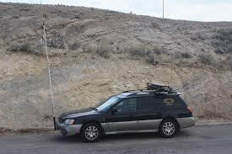
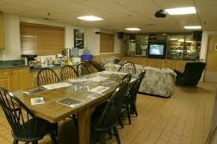
Where would you rather spend 4 days?

Slide 14
All-In-One, GoBox, EMCOMM Box, etc
There are countless variations.
Cost can range from less than $50 to more than a New 4x4 Pickup.
For this evenings examples, Low Cost and Simplicity are top priority!

Slide 15
VHF/UHF All-In One for local Op’s.
Most Ham Operators have working spare gear collecting dust on a shelf or in a drawer.
Let’s see how we can put that gear back in service!

Slide 16
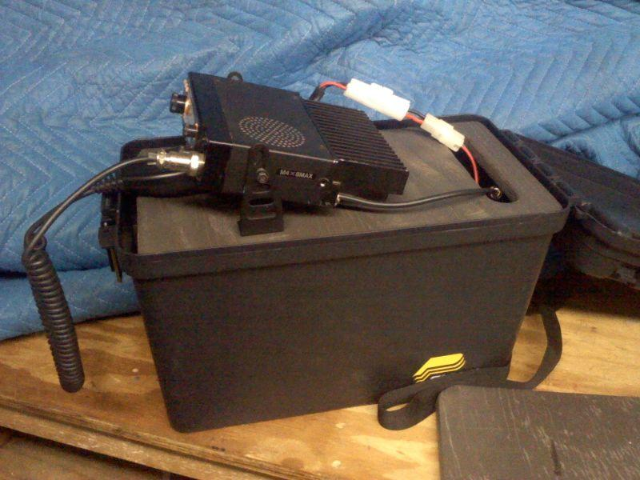
VHF/UHF All-In-One for Local Op’s
Spare Rig: Kenwood TM-231
Container:
Plano 1612

Slide 17
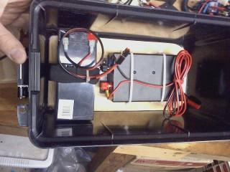
VHF/UHF All-In-One
On-Board Power Sources:
MFJ 4115 -12v Power Supply
7.5 Ah 12v SLA Battery

Slide 18
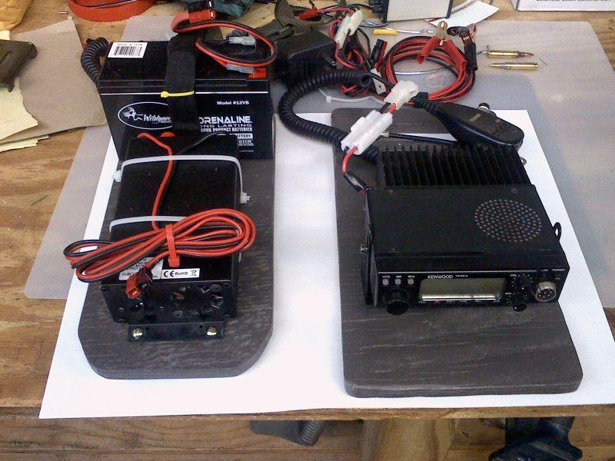

Slide 19
VHF/UHF All-In-One
Antennas to pack:
N9TAX Roll-up JPole
Tram Dual Band Mag Mount
More 12v Power Options:
Long Power cable w/ Clips for External 12v
Battery Tender or Charger
Anderson Power Poles

Slide 20
VHF/UHF All-In-One
Utilizes simple to operate spare rig.
Small Footprint to save space.
Redundant power options.
Portable for Mobile use. Stable for Base use.
Virtually Self-Contained

Slide 21
Local Clubs & Individuals
We’ve seen that there is a need for Portable/Mobile gear.
For a Minimal Investment a Club/Group could build a few All-In-One boxes to be used if needed in an Emergency or local function.
Individuals could utilize spare gear to outfit for future use.

Slide 22
Local Clubs & Individuals
Future training topics could include:
Assembling “All-In-One” units
Building Roll-up JPole Antennas
Incorporating Digital Modes to the All-In-One
Field Testing Units (Repeaters/Simplex)

Slide 23
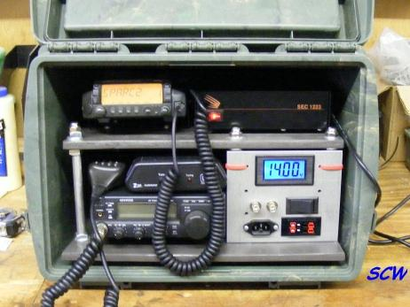
What about HF?-Yep, we can do that too!

